Slide 1
A frogs life
Ava Madison

Slide 2
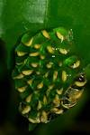
first The frogs lay eggs.

Slide 3
Secend It turns into a tadpole.

Slide 4
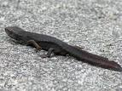
Third A tadpole grows its legs.

Slide 5
Fourth It turns into a froglet.

Slide 6
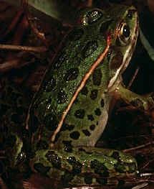
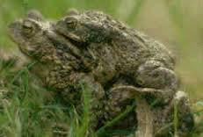
fifh It turns into a frog.

Slide 7
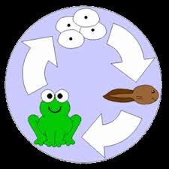
A life cycle of a frog.

Slide 8
Frogs life

