Slide 1
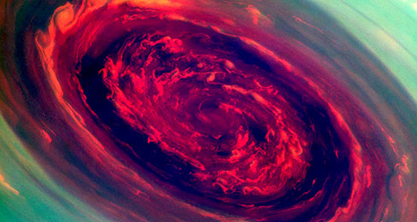
what is a hurricane
EPHRAM & Aidan

Slide 2
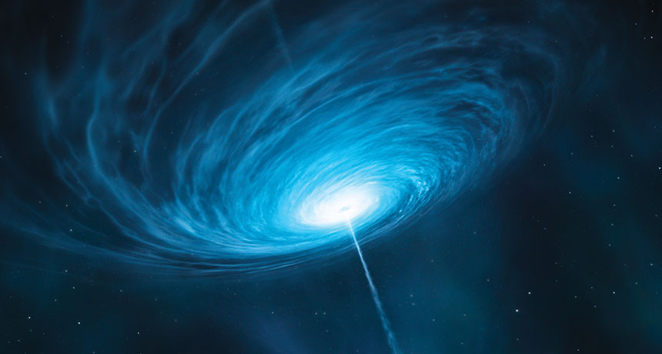
how fast it is?
(200 kilometers 124 million miles)per hour. That’s nearly one –fifth the speed of light.

Slide 3
how is it made?
The sun picks up water it go’s up into clouds then the clouds spin to make a hurricane.

Slide 4
How does a hurricane get heat
A hurricane gets heat from the sun.

Slide 5
thank you!

