Slide 1
How does the eye see?
By Cooper B.

Slide 2
We all know:
An eye sees an image up side down.
But: the brain flips it right side up.

Slide 3
One way to say it is:
An eye may be able to reflect light.
This means the reason you are blind your eyes can not reflect light.

Slide 4
One cool fact is:
Eyes watering is just tears.

Slide 5
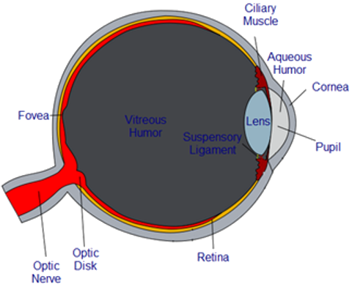
These are the parts of the eye.
These can help your eyes work and see. If something happens it could make you blind.

Slide 7
Cool stuff/By the way.
Eyes are really cool!!!!!!
Staring contest
Seeing decorations
Looking at pretty stuff
Without eyes you couldn’t do any of these!

Slide 8
Thanks!
Thank you for watching! hope you enjoyed it! Bye!

